Slide 1

LinguaVox
Avinash Ravi (C0791941)
Ankur Rokad (C0793757)
Sahista Patel (C0796681)
Ummer Shariff (C0791871)
Vishal Sabrinath (C0801202)

Slide 2
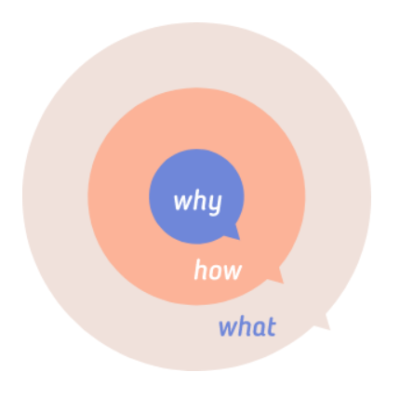
Golden Circle
We believe everyone deserves an equal opportunity to express themselves and effectively communicate.
We believe in less dependency, more autonomy!
Our product breaches the gap between ability and disability. It is user friendly, responsive and beautifully designed.
We made LinguaVox - The web application.

Slide 3
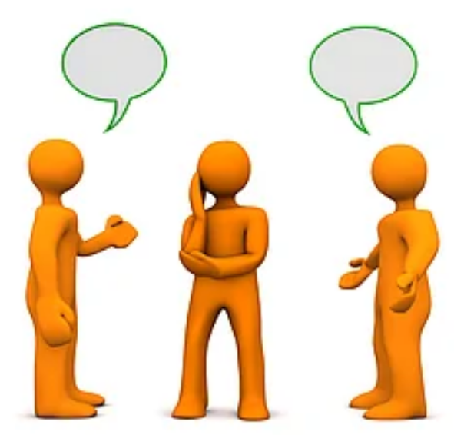
Our Values
Influence:
It is a step towards inclusive society.
Mission:
Eliminate the barrier between normal and physically challenged people.
Vision:
Society without communication barrier.

Slide 4
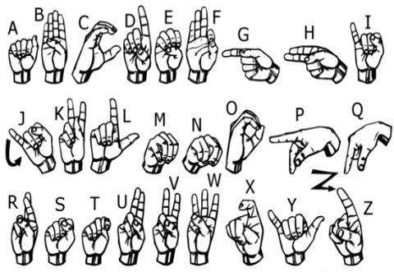
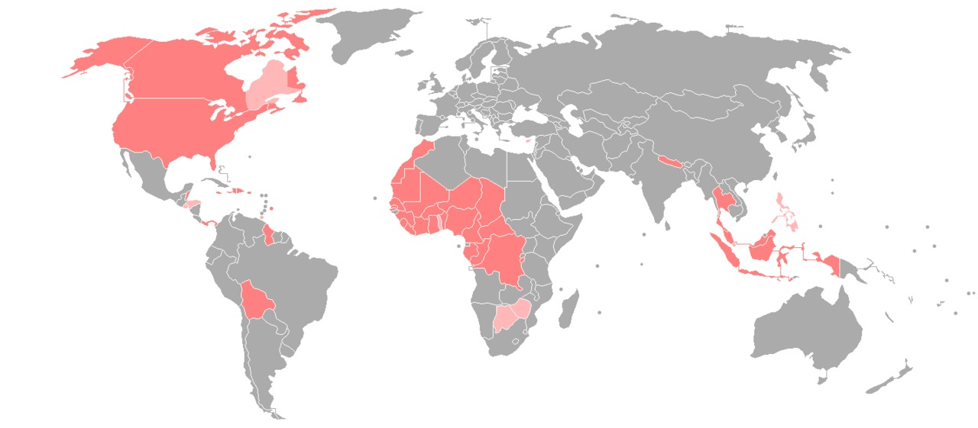
Sign Language
American Sign Language (ASL)
Three most common:
American Sign Language (ASL)
British Sign Language (BSL)
Australian Sign Language (Auslan)
Over one percent of Canada’s population or approximately 466,420 people are deafblind. In Ontario, an estimated 211,250 individuals are deafblind.
250,000–500,000 in the United States (1972)[1]: 26 L2 users: Used as L2 by many hearing people and by Hawaii Sign Language signers.

Slide 5
Project Milestones
Inception
Team Kick-off
Project Concept
Requirements
Deployment
Project Workflow
Tools & Technologies
Data Sources
Pilot Release
Testing
Bug Fixes & Maintenance
Final Release
Testing
Feedback
Development
Model
API Framework
UI Development
Integration
Presentation
Demonstration

Slide 6
Data Collection
Labels
Multiple images of friends
Conference
TED talk or conference
Lecture
Professor’s lecture
Labels
Multiple images of own
Own
Capture images of members
Video Frames
Get any video and capture frame
Word Level
Sign Vocabulary
Data
For modelling
Sensory Devices
Glove based approaches
Labels
Frequently used labels
Expensive
Buy special gloves
User Friendly
Not feasible
Fingerspelling
Hand gesture of each alphabet
Facial Expression
Body Gestures
Hand gesture
Chart

Slide 7
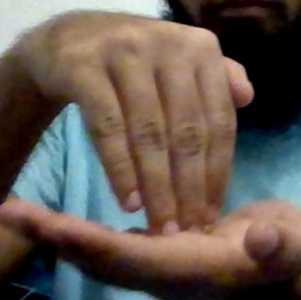
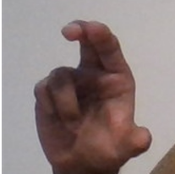
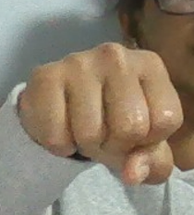
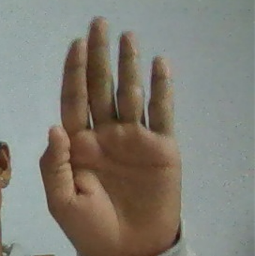
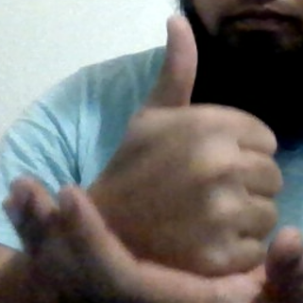
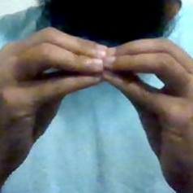
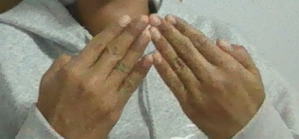
Data Preparation
MULTIPLE Images
MULTIPLE Images
AGAIN Label
YES Label
NO Label
HELP Label
Hello Label
MORE Label
THANKS Label
MULTIPLE Images
MULTIPLE Images

Slide 8
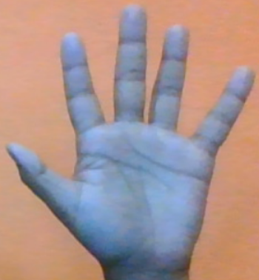
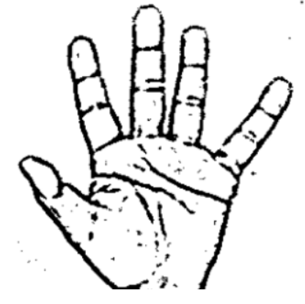
Strategy
Characters
Get characters from input
Text to Sign
Text to Sign frames
Images
Select alphabets from directory
Two groups
Meet deadlines
Fingerspelling
Alphabets
Sign to Text
Sign to alphabets, words/sentences
Filter
Gaussian blur filter
Noise
Remove Blur

Slide 9
Backend & UI
Step-2
Classify between similar symbols
Camera
Camera Integration
UI Design
Complete interactive UI
Host
Hosting Environment
Step-1
Classify between 27 Symbols
Two groups
Meet deadlines
Backend
Work on ML model
Model CNN
Convolutional Neural Network
Training
CNN & TF [Func]
Layers
Convolution | Window size [5*5]
Pooling | Max & Average Pooling
Flattening, Fully Connected & Output Layers
Training
Noise | RGB -> Grayscale Gaussian Blur
Resize | [128*128]
Optimization using cross-entropy

Slide 10
CNN Layering Structure
1 X 128 X 128
Convolution
32 X 126 X 126
Max Pooling
Output Layer
32 X 63 X 63
Convolution
Fully Connected Layer
32 X 61 X 61
28800
Flatten
Max Pooling
32 X 30 X 30

Slide 11
Layering
Letter
Detected >50 frames then consider
Word
Space between words as blank symbol
Layer 1
Classify between 27 Symbols
OpenCV
Gaussian blur & threshold for feature extraction
For Letters | Model Gives
D | R, U
U | D, R
I | T, D, K & I
S | M, N
Testing
Confusion
Layer 2
Classify between similar symbols
Set
Set of Symbols
Classifiers
Specific sets

Slide 12
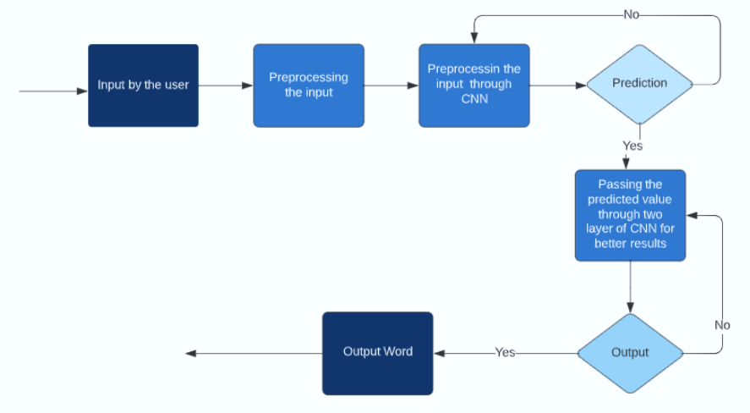
Gesture Classification

Slide 13
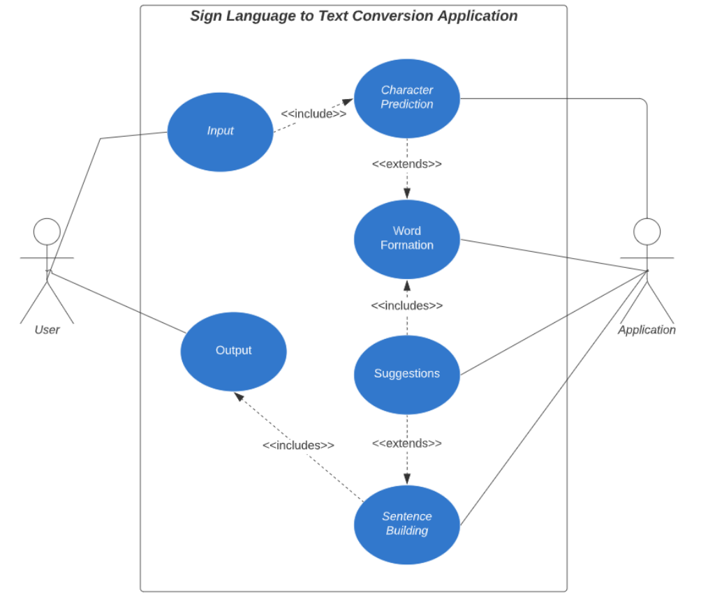
Working

Slide 14
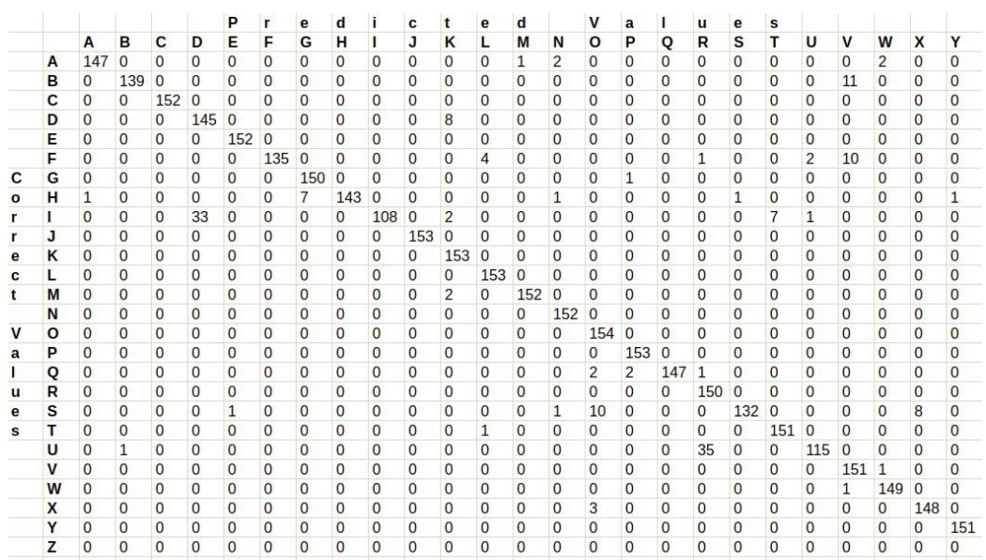
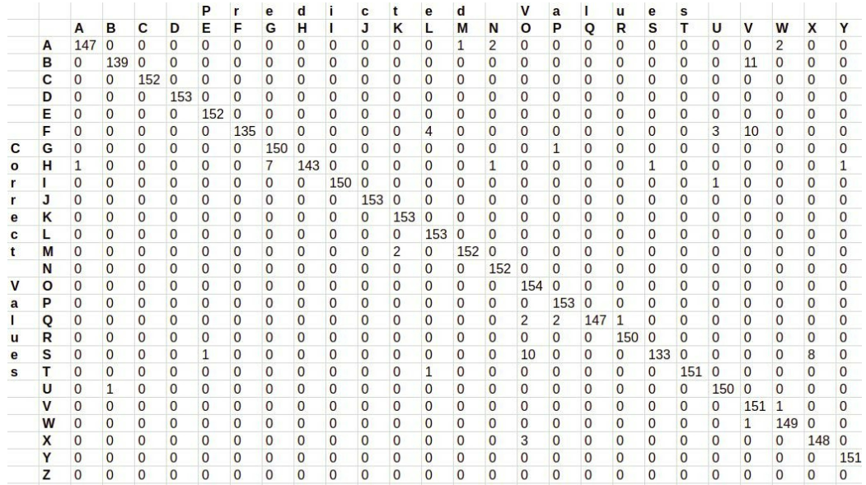
Model Evaluations
Layer 2: 97.0%
Layer1: 95.8%
Confusion matrices

Slide 15
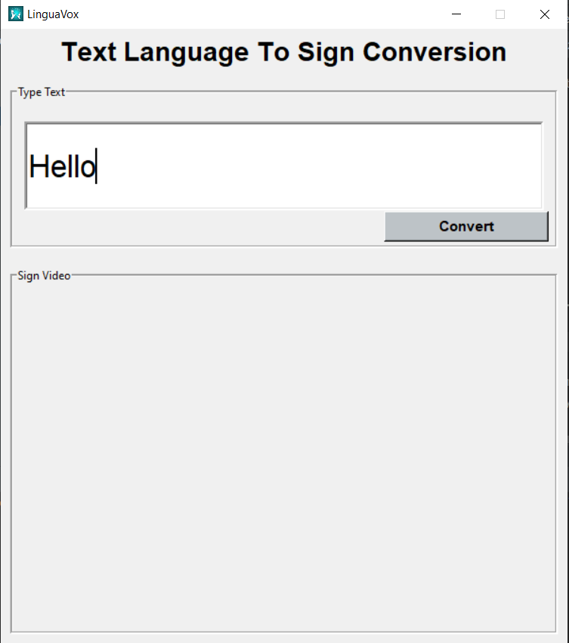
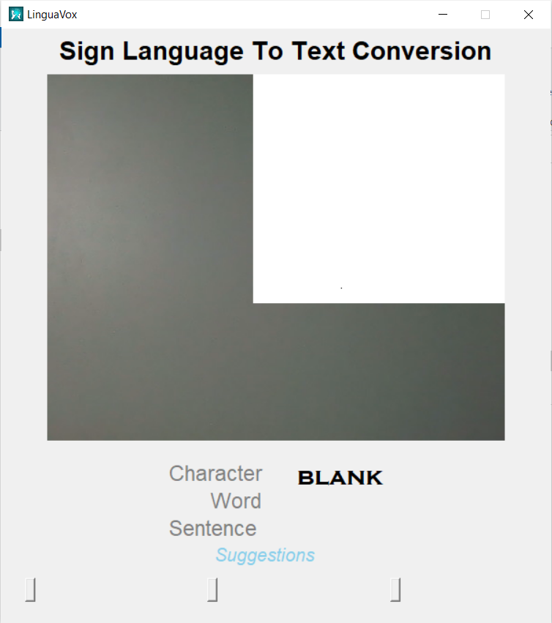
Modules
Characters
Get characters from input
Text to Sign
Text to Sign frames
Images
Select alphabets from directory
Two groups
Meet deadlines
Fingerspelling
Alphabets
Sign to Text
Sign to alphabets, words/sentences
Noise
Remove Blur

Slide 16
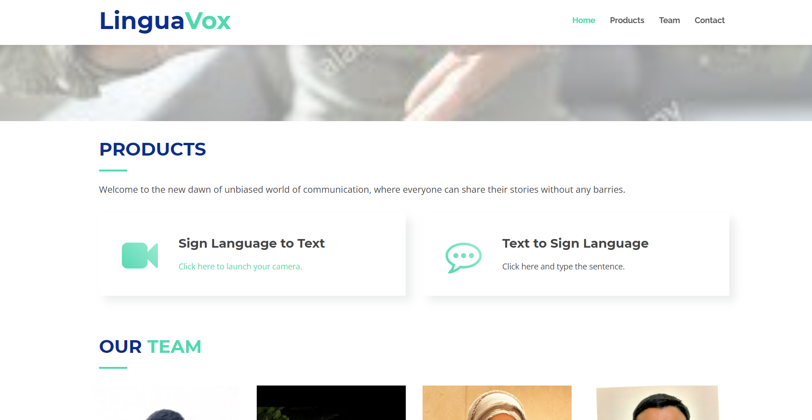
Metadata
Text
Input Text which must be converted
Action
Button to render the video
Detect
Fingerspell detect after Gaussian blur filter
Camera Frame
Camera port captured entire frame
Display
Frame to display video
Character
Predicted character
Word
Formed word
Sentence
Prepared sentence
Suggestion
Hunspell package

Slide 17

Example Video…

Slide 18


Slide 19
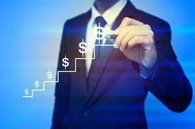
Selling Point
Accessibility is not luxury, but a necessity…
Answer the important questions:
What are we selling?
To whom are we selling?
How we will be marketing? …

Slide 20
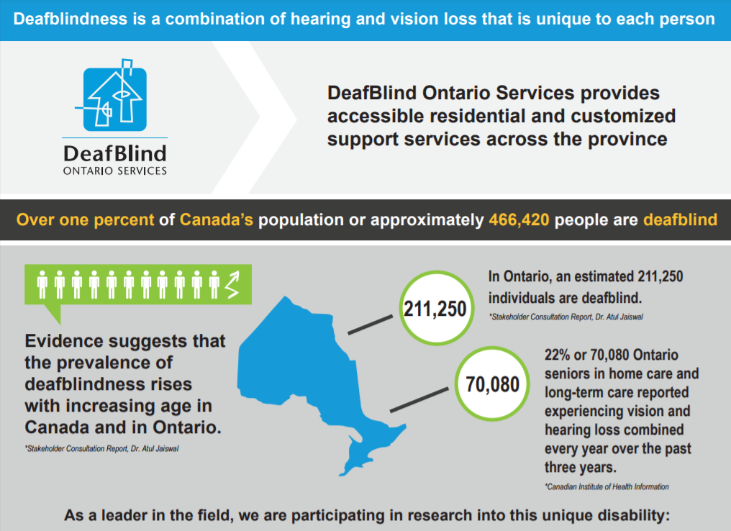

Slide 21

Revenue Estimates
 | 2022 | 2023 | 2024
Number of Users | 1000 | 10000 | 100000
Number of Product Sold | 600 | 6500 | 89000
Price per Product | 100 | 120 | 150
Total Revenue | 60000 | 780000 | 13350000

Slide 22
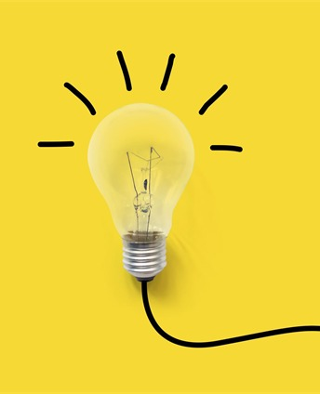
Future Scope
User Feedback platform
Streamlining the application development
Continuous performance improvements & patch release
Focus on product marketing
Increase in customer base

Slide 23


Questions ?

Slide 24
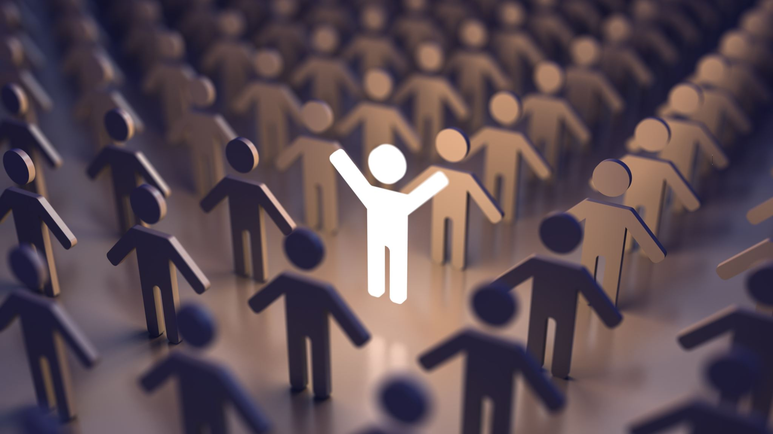
Thank you LinguaVox:
Avinash
Ankur
Sahista Vishal Ummer

